Slide 1
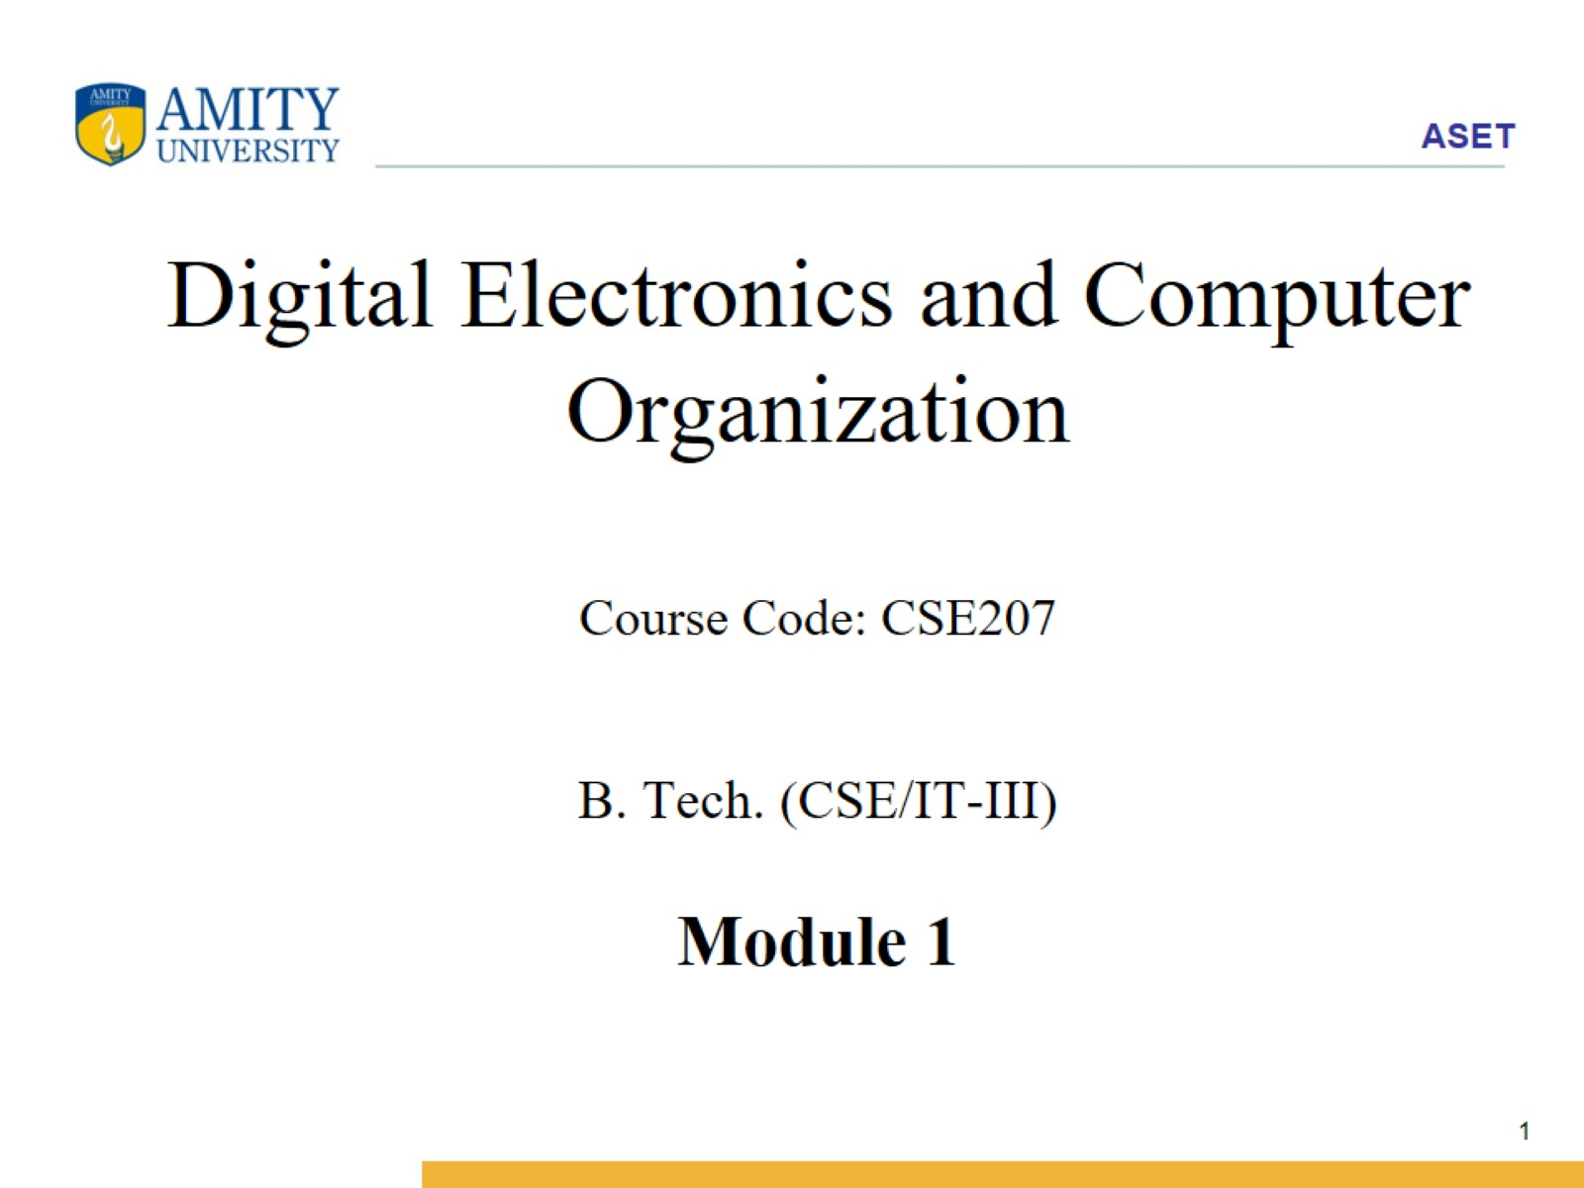
Digital Electronics and Computer Organization Course Code: CSE207 B. Tech. (CSE/IT-III) Module 1

Slide 2
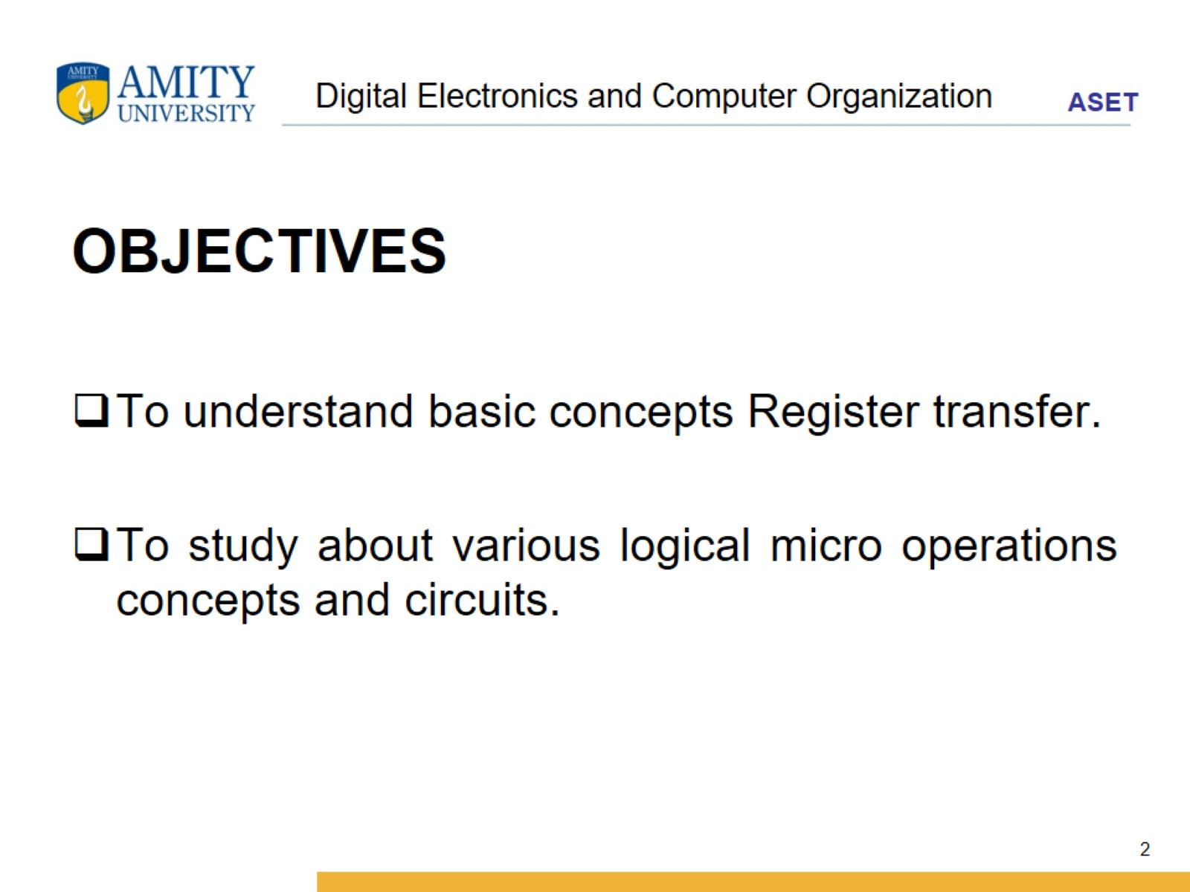
Digital Electronics and Computer Organization

Slide 3
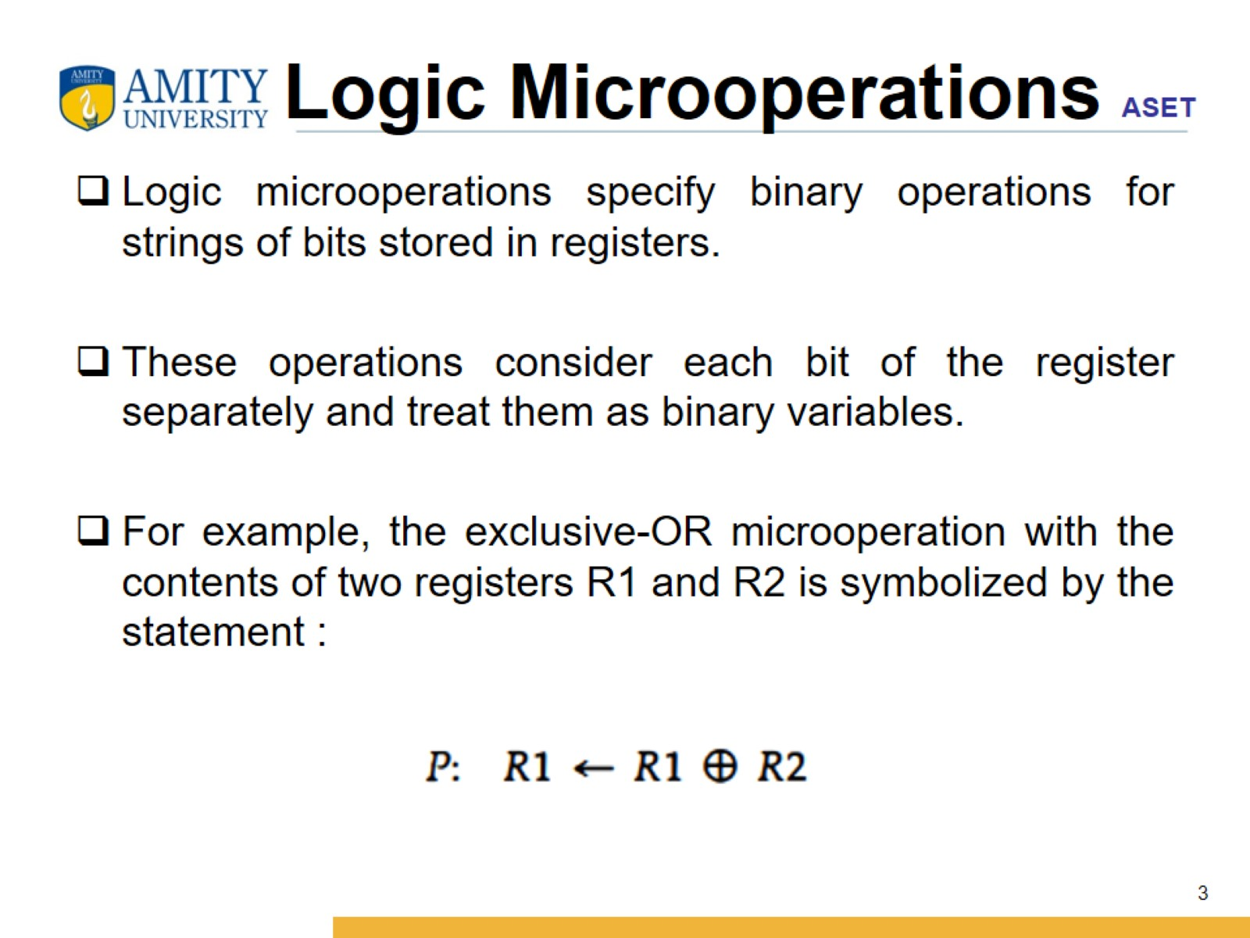
Logic Microoperations

Slide 4
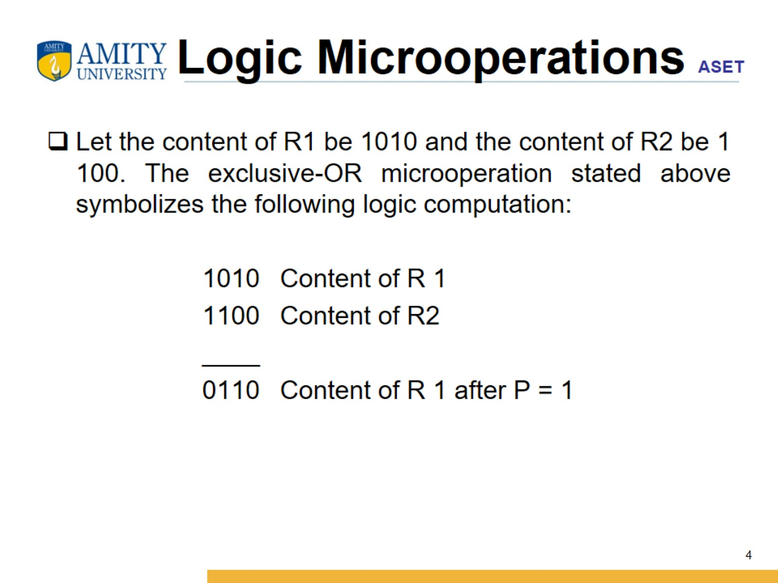
Logic Microoperations

Slide 5
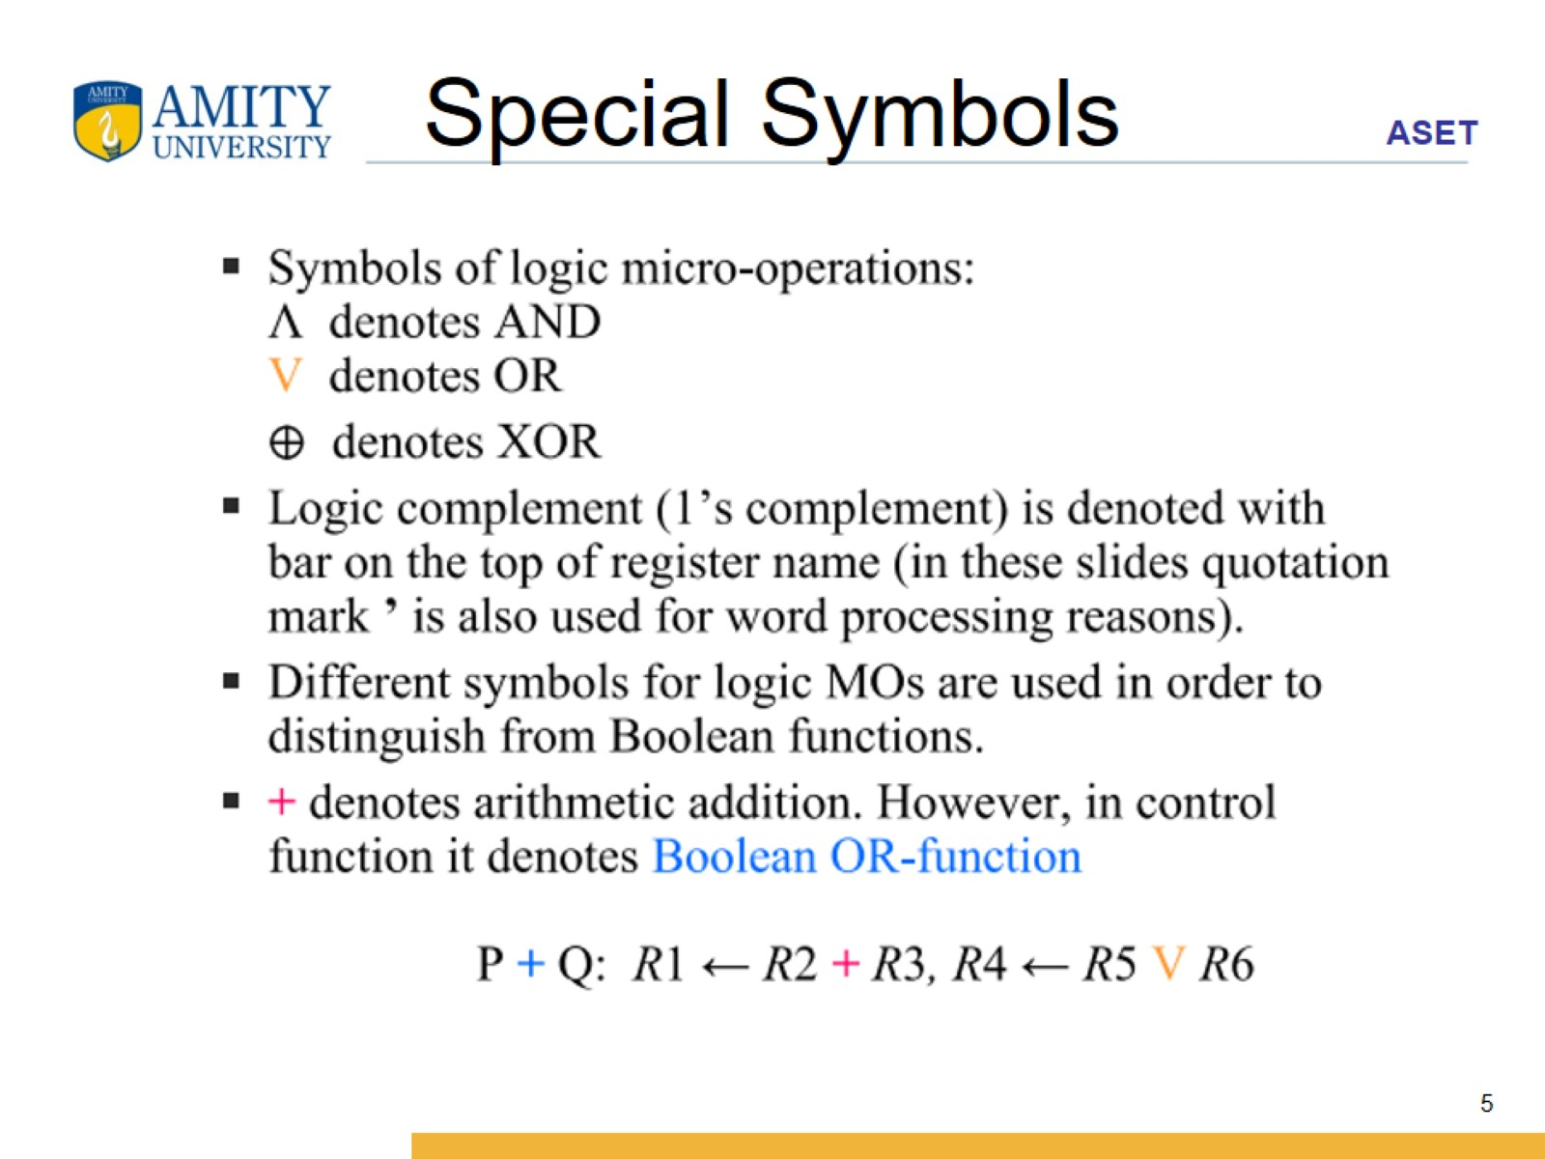
Special Symbols

Slide 6
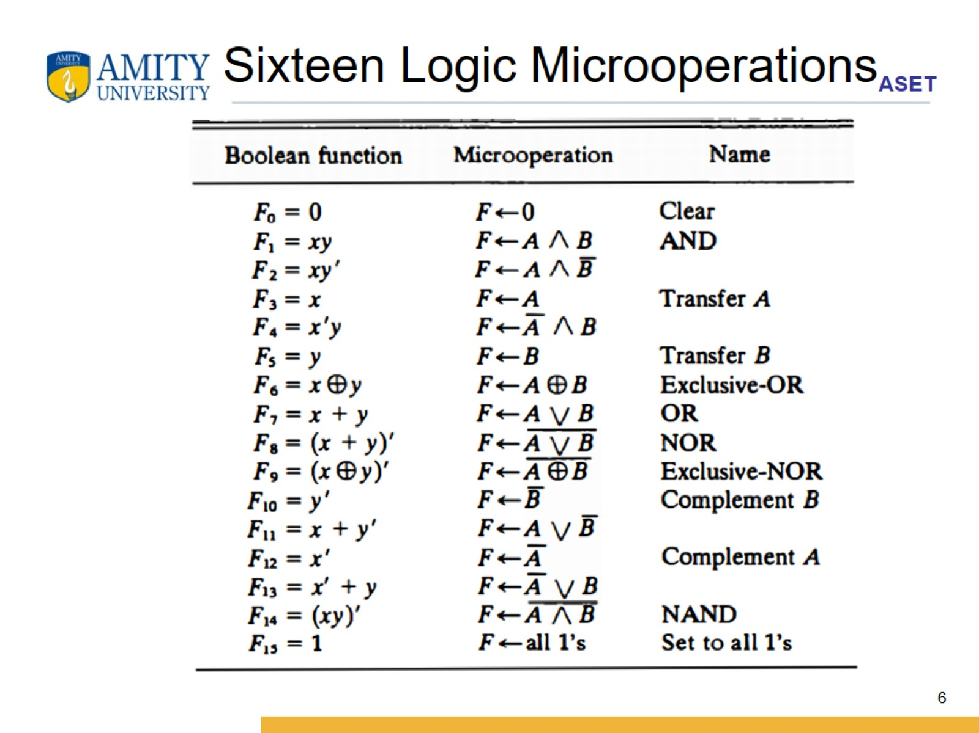
Sixteen Logic Microoperations

Slide 7
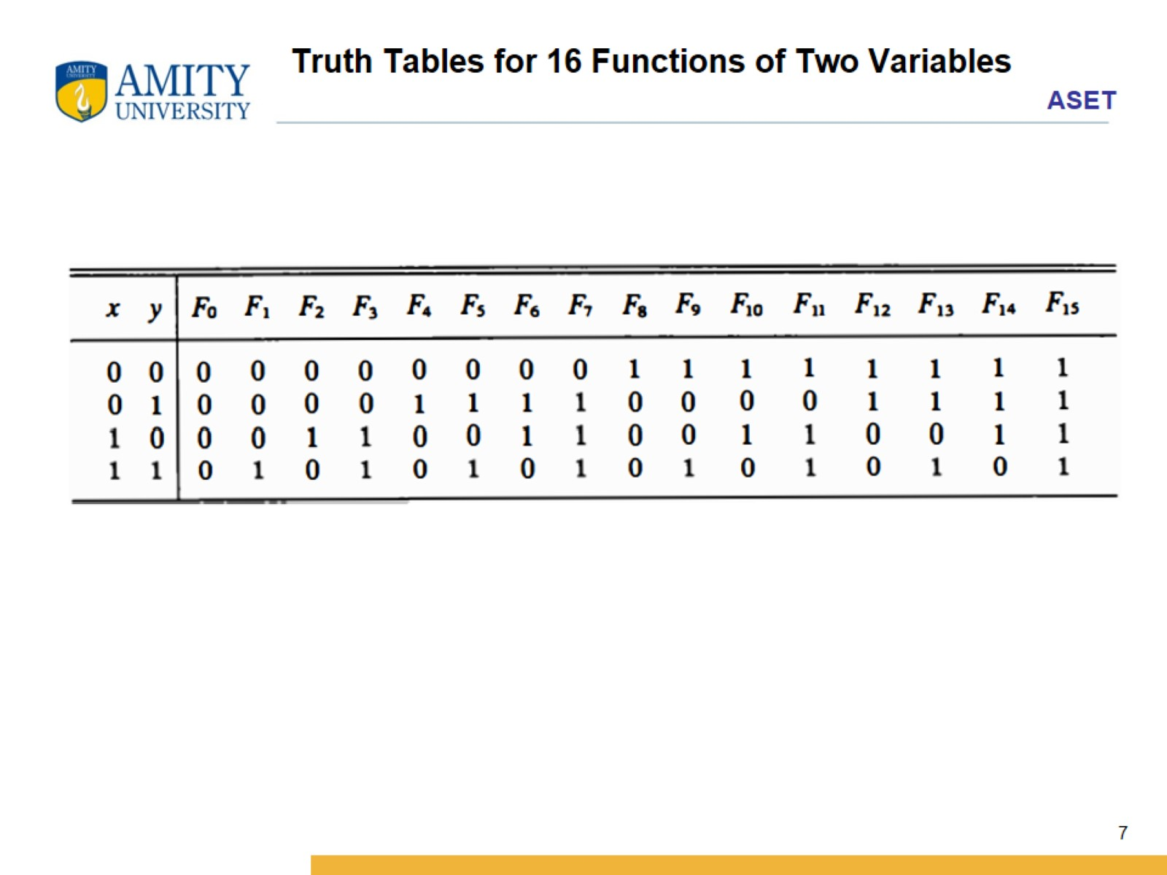
Truth Tables for 16 Functions of Two Variables

Slide 8
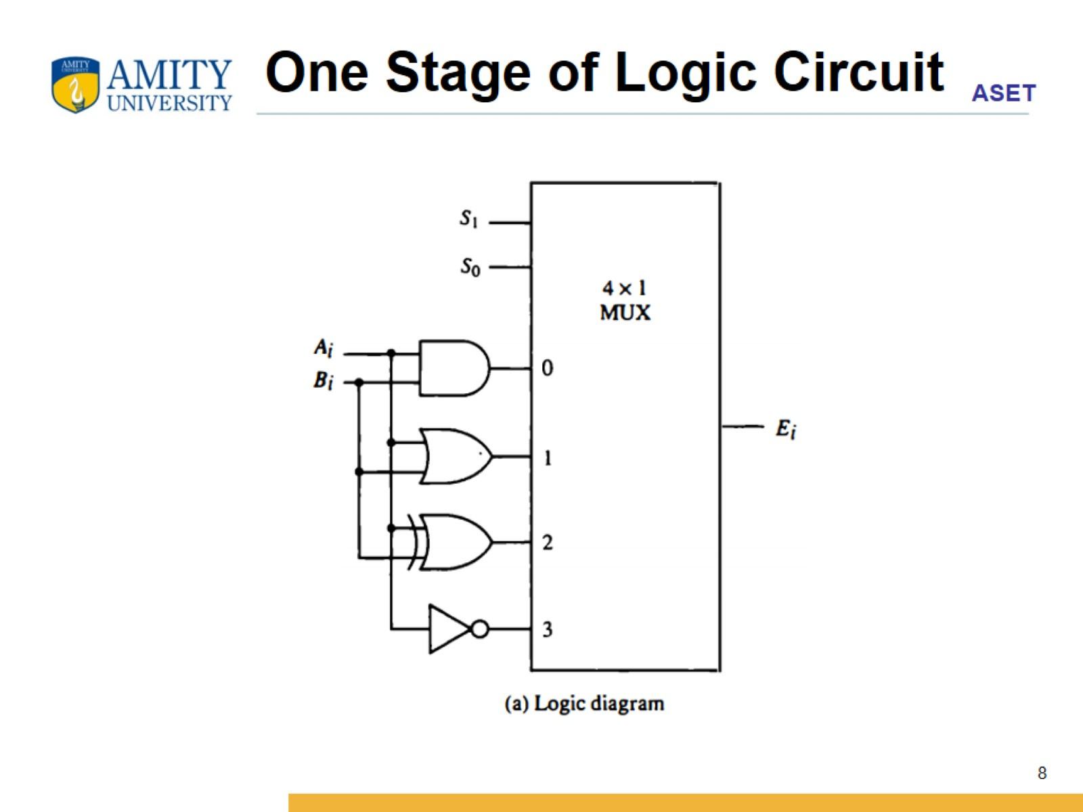
One Stage of Logic Circuit

Slide 9
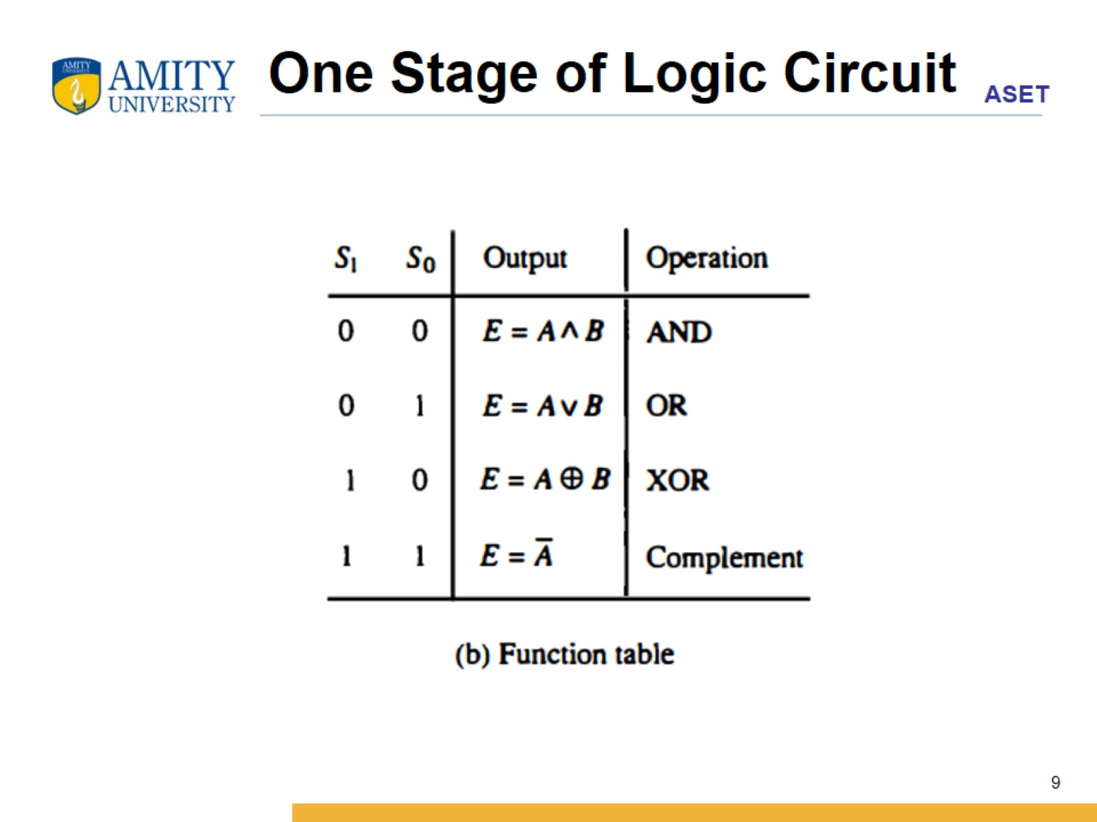
One Stage of Logic Circuit

Slide 10
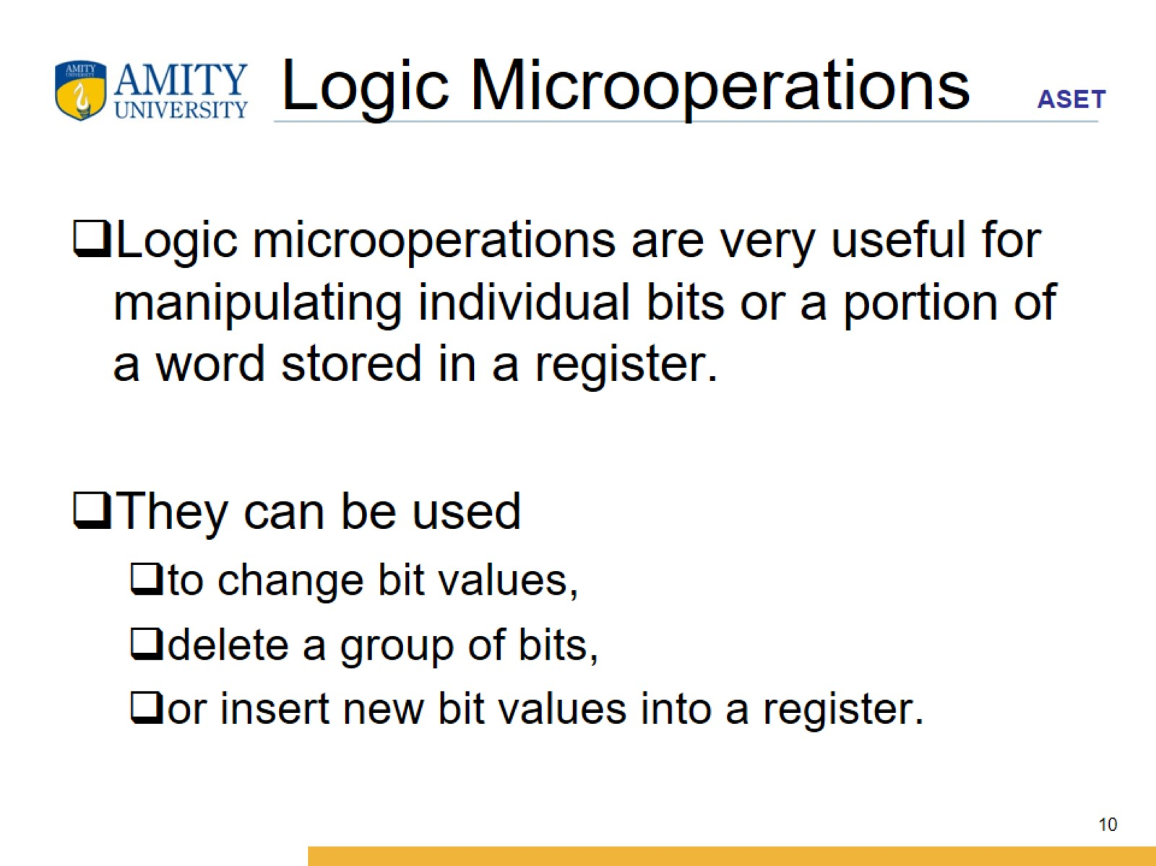
Logic Microoperations

Slide 11
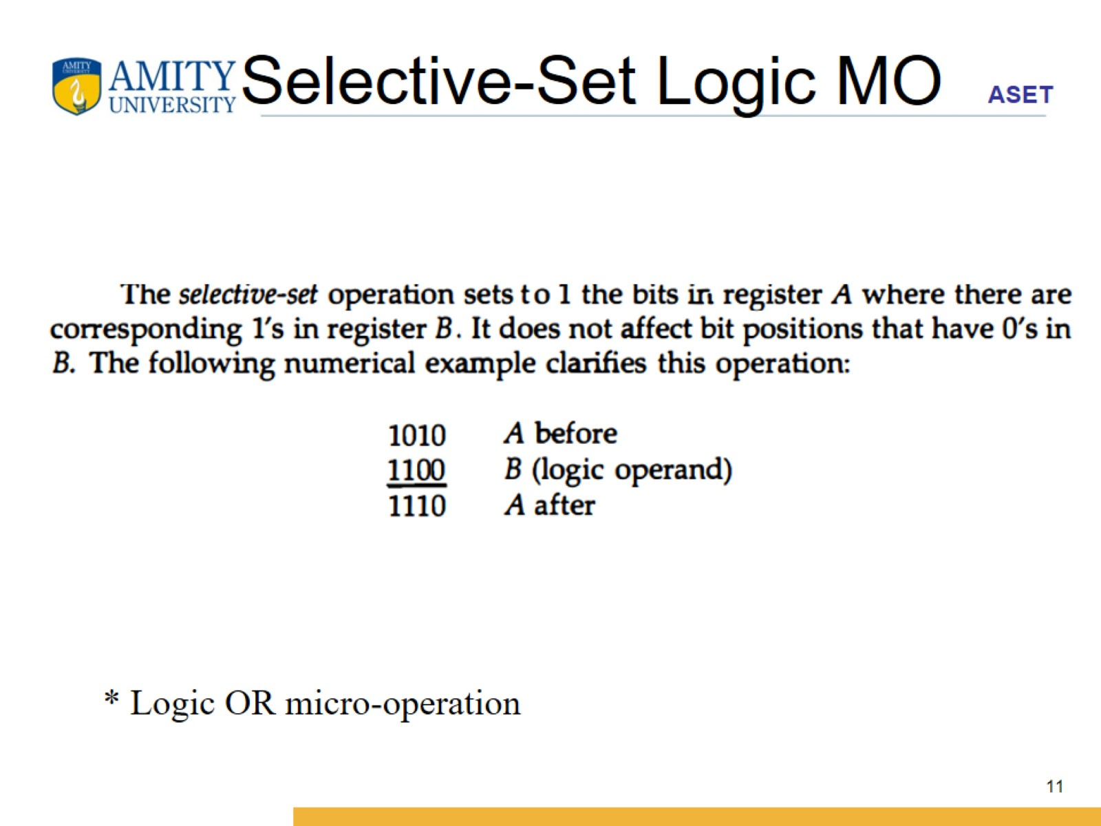
Selective-Set Logic MO

Slide 12
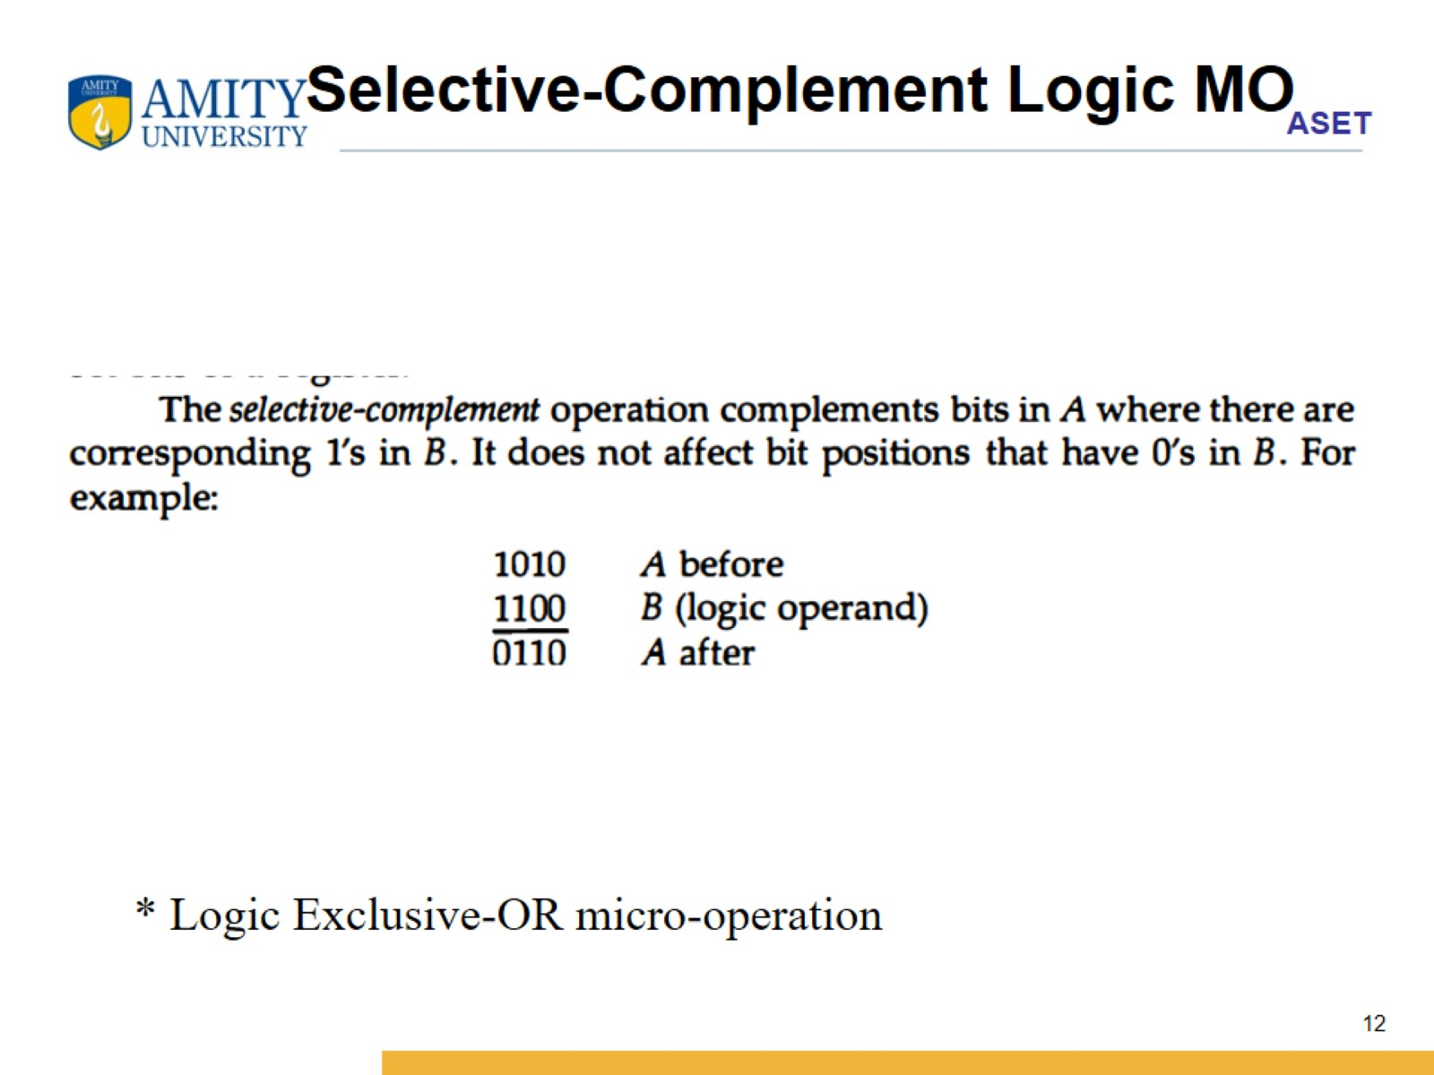
Selective-Complement Logic MO

Slide 13
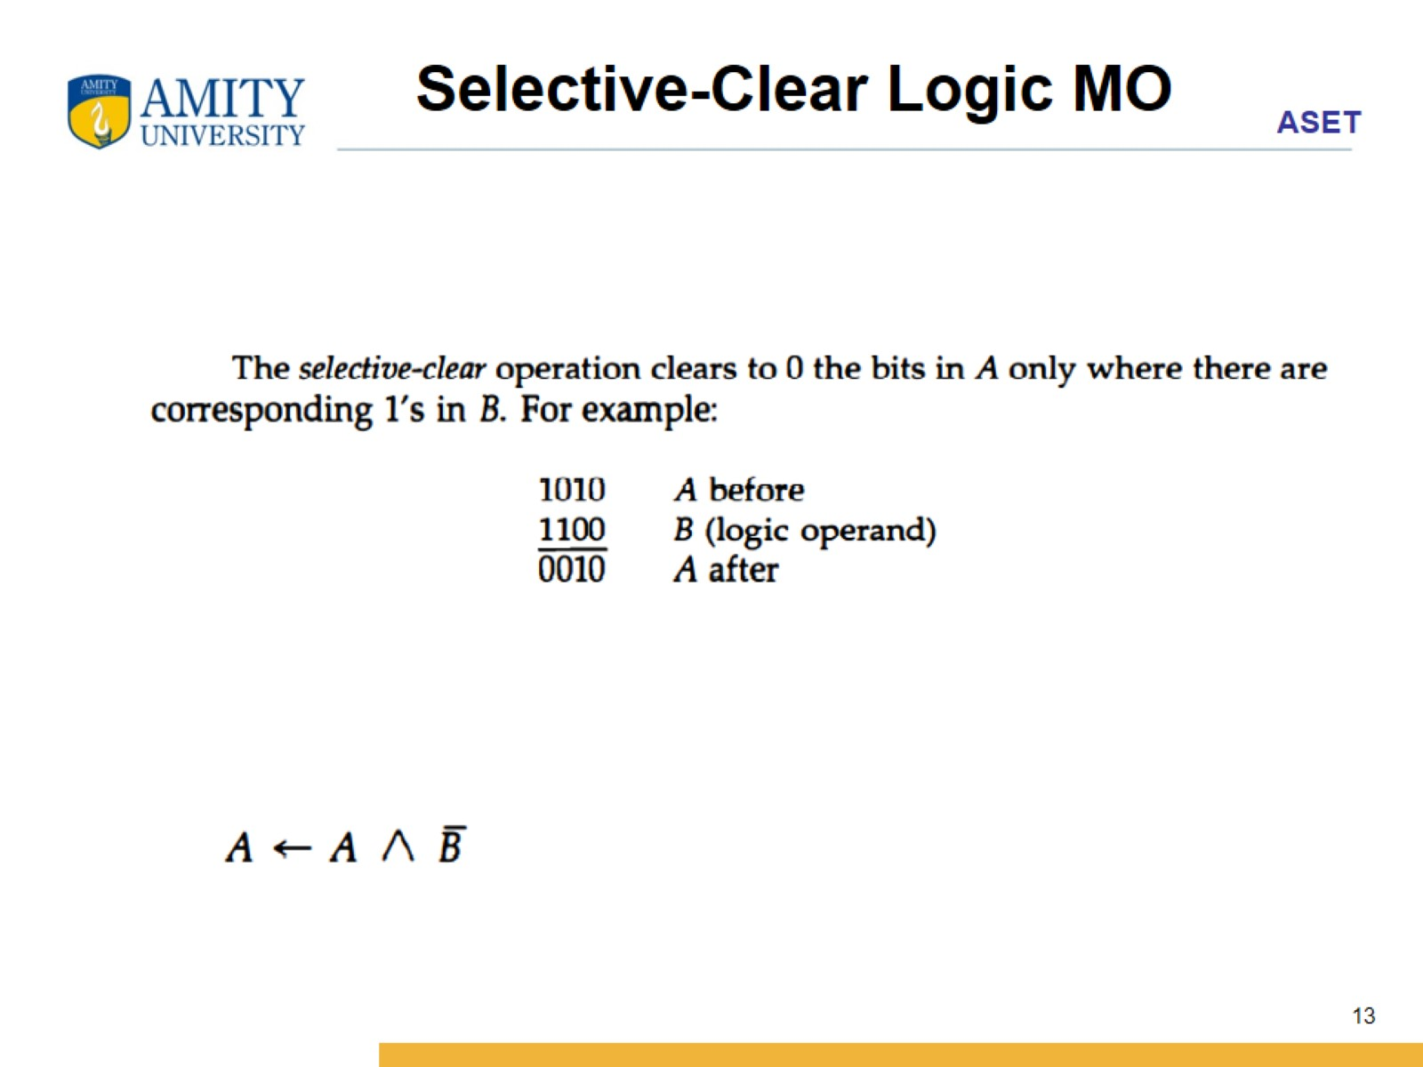
Selective-Clear Logic MO

Slide 14
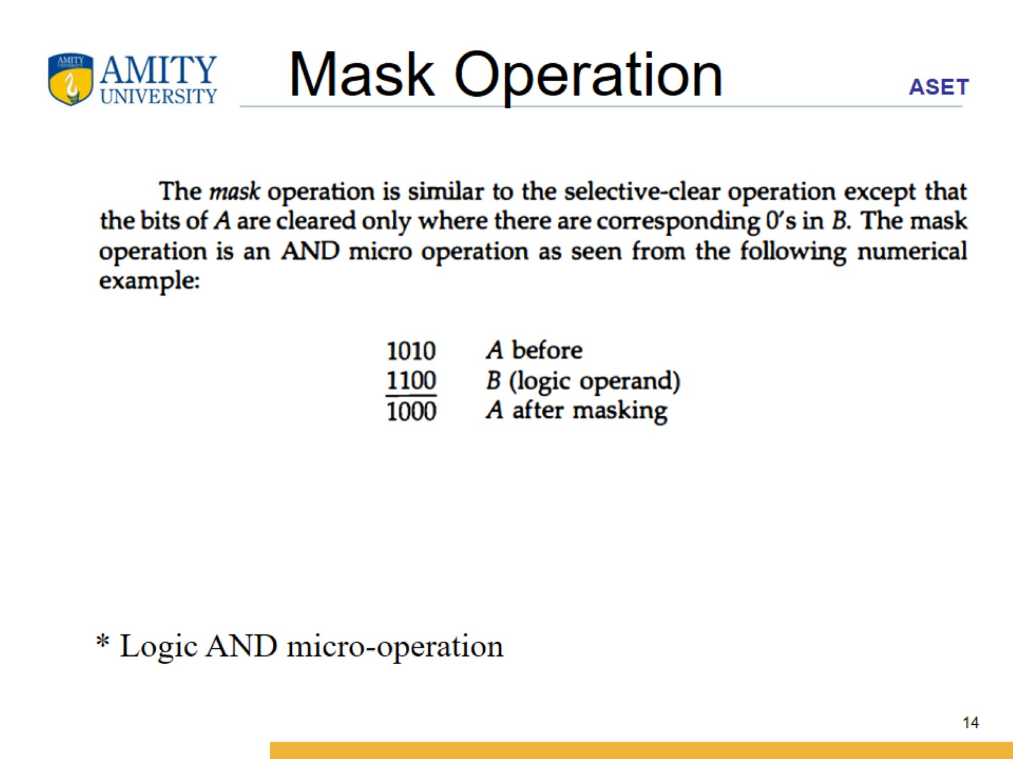
Mask Operation

Slide 15
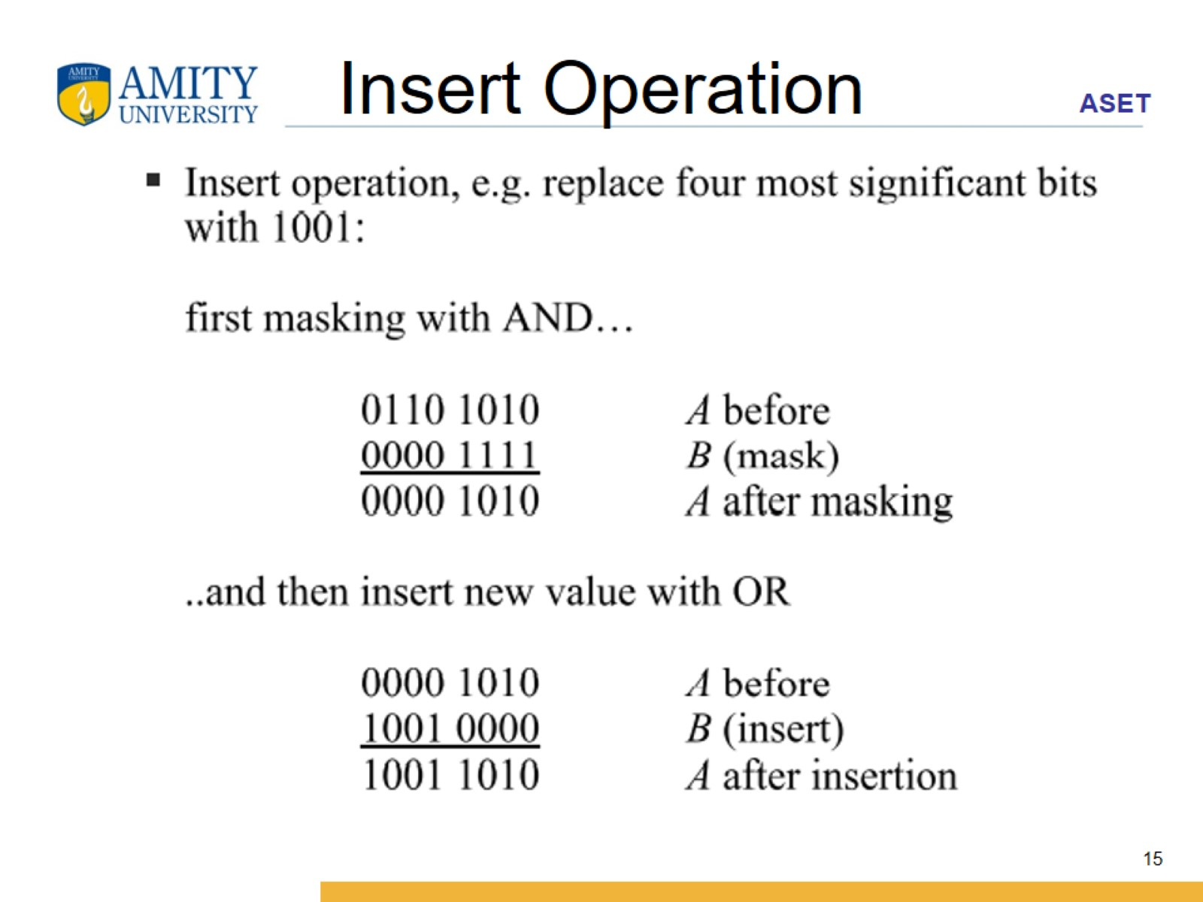
Insert Operation

Slide 16
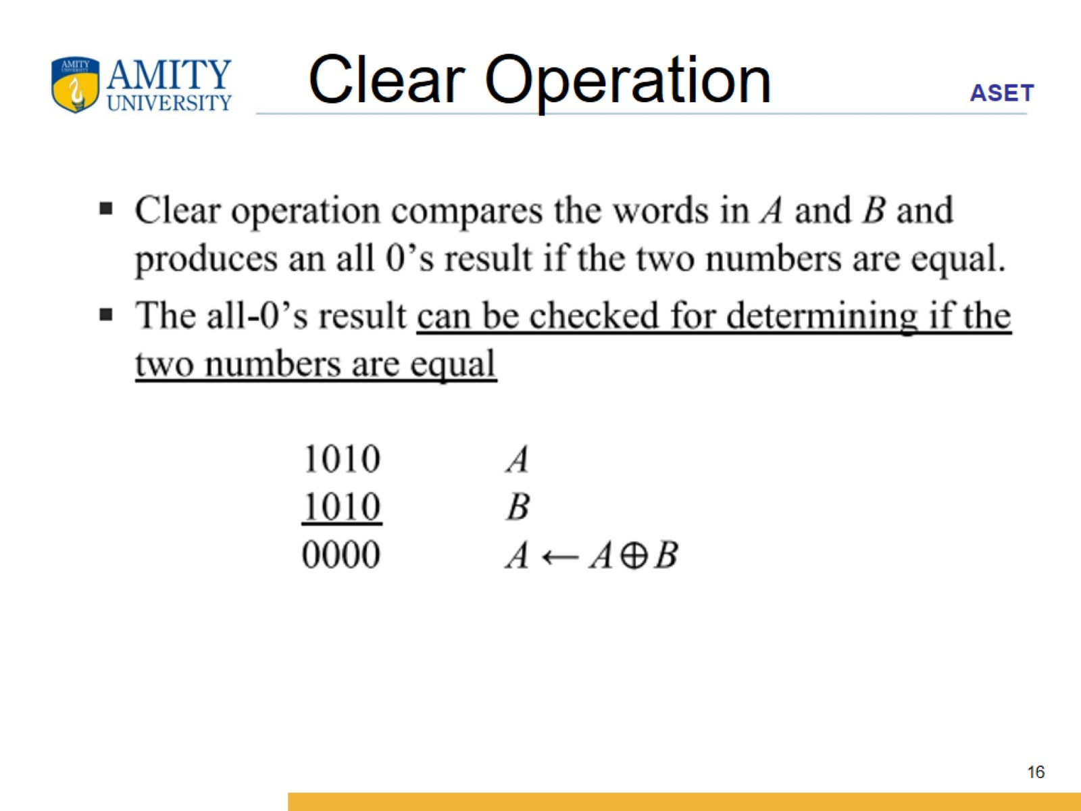
Clear Operation

Slide 17
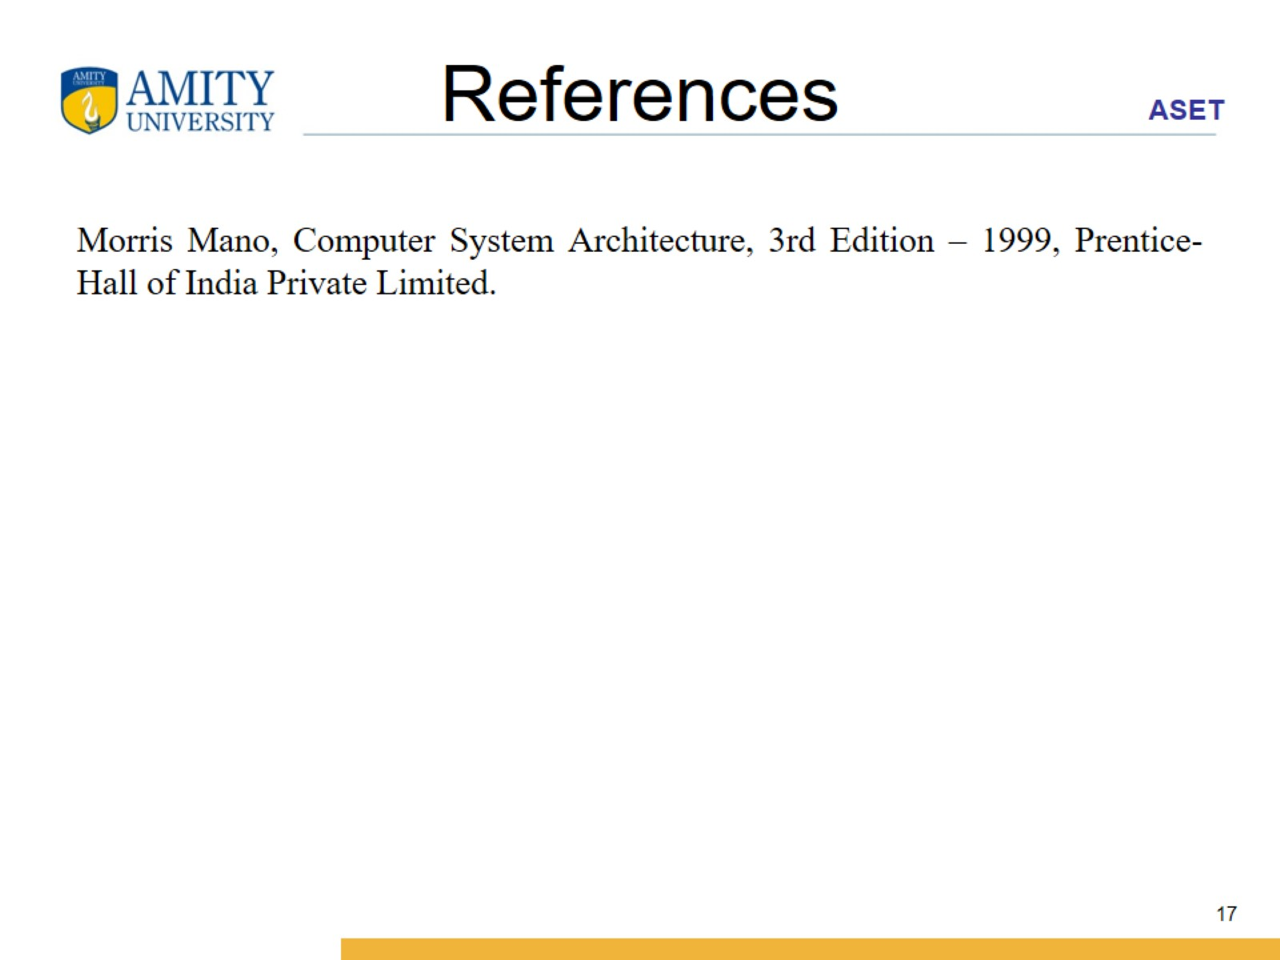
References

